Slide 1
Getting level of a node in Binary tree
By Saranya Kesavan

Slide 2
Problem Statement:
Write a Java program to get level of a node in binary tree?

Slide 3
Algorithm :
If node is null then return 0
If node’s data is equal to key, then return level.
Recursively search key in left subtree
If not found, then search in right subtree

Slide 4
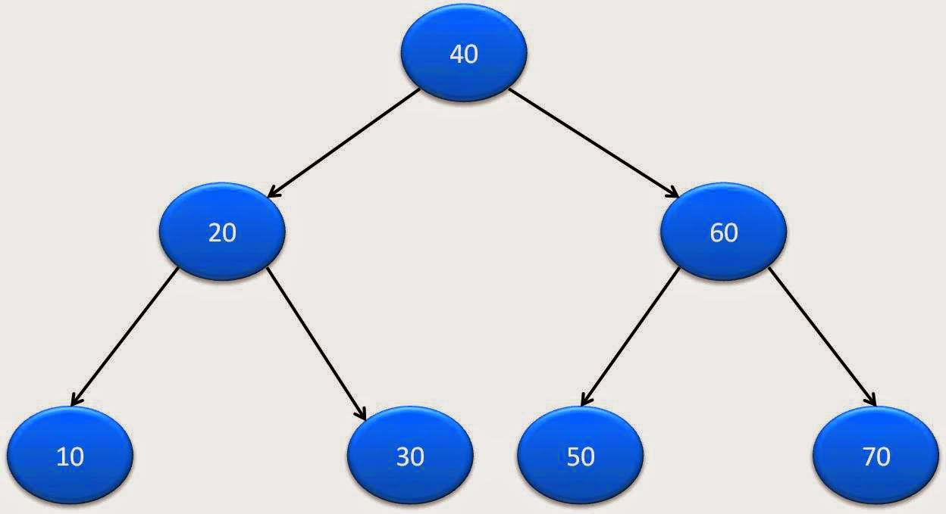
Example
Consider a binary tree,

Slide 5
Solution:
Root will be at level 1.
search for a key in binary tree.
If key not found in binary tree then its level will be 0.

Slide 6
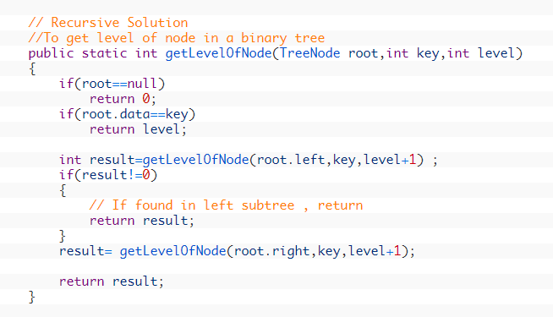
Recursion Code:

Slide 7

Output:

